Slide 1
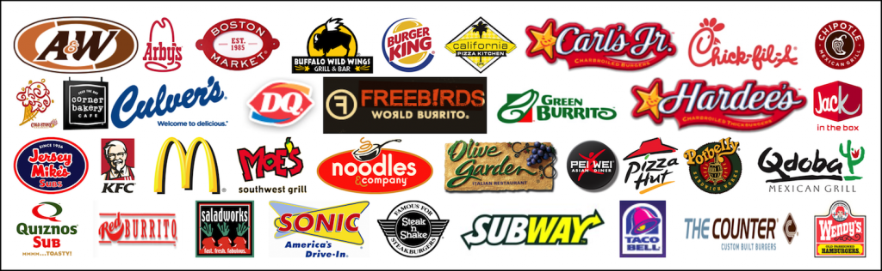
Fast Food Restaurant Chains in USA
Project - Term 1&2: Exploratory Data Analysis

Slide 2
Problem Statement
A Fast Food Restaurant, also known as a Quick Service Restaurant (QSR) within the industry, is a specific type of restaurant that serves fast food cuisine and has minimal table service. Arguably, United States is the birthplace of the first fast food restaurant called "White Castle" in 1921. Today, American-founded fast food chains have grown as multinational corporations and having outlets across the globe, However the growth and preferences of the fast food restaurant chains within USA are not uniform.
Notes:
A fast food restaurant which is also know as a quick service restaurant is a type of restaurant wherein fast food cuisine is served which is mostly a self served. A fast food restaurant term has come from United States of America and this EDA study is focusing on analysis the current trend of fast food restaurants in USA.

Slide 3
EDA Objective
Understand the data which is available for 10000 Fast Food Restaurants in USA by performing an EDA procedure and provide data insights to a person/group to make a decision on investment/s into fast food restaurant business or a franchisee of an existing fast food restaurant brand.

Slide 4
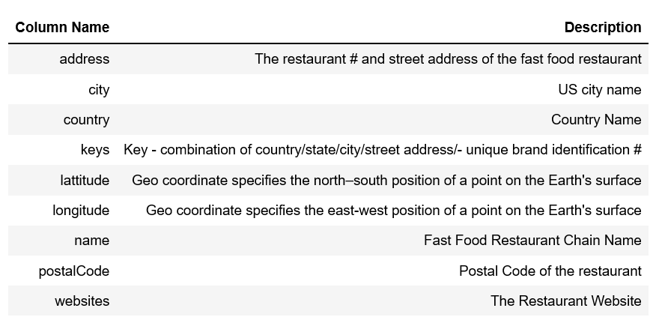

Data Information Available
Data appears to be captured through an online survey wherein data is captured through free form fields in certain places instead of providing list of preferences. Not all fields in the survey where Mandatory.

Slide 5
Transform Data using Pandas Profiling
Data Collection Suggestions
Provide preference list for selection of Provinces (States and/or Federal Districts) in order to avoid bad entries.
Complementary Data
Column added to label fast food restaurants by USA Regions.
Column added to differentiate cities with same name across different states.
Processing database base on recommendations received in pre profiling of database which is done using pandas packages.

Slide 6
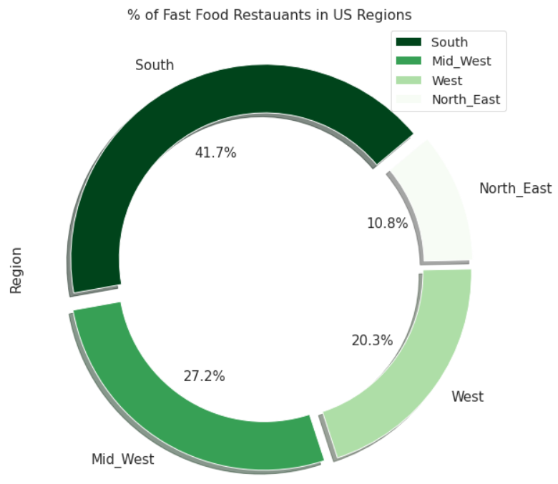

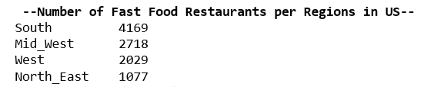
Fast Food Restaurants by USA Regions
Fast Food Restaurant Numbers are HIGH in South Region where as LOW in North East Region.

Slide 7
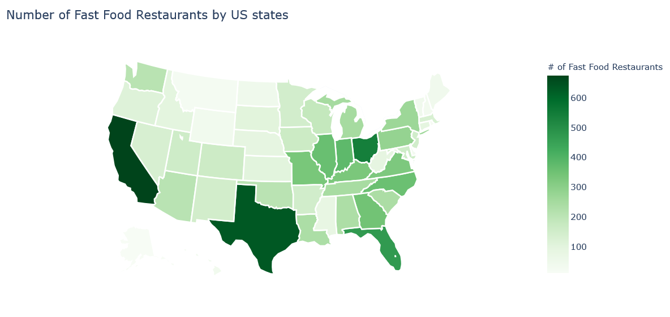
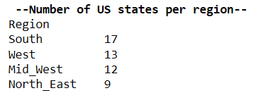
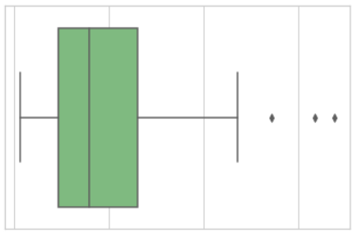
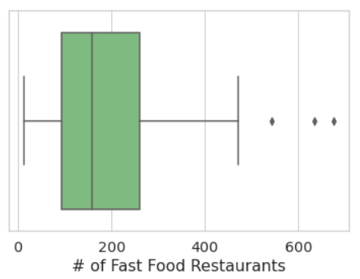
Fast Food Restaurants by USA States
OH
TX
CA
California, Texas and Ohio are the US states with MOST NUMBER of Fast Food Restaurants.
# Fast Food Restaurants spread in US states

Slide 8
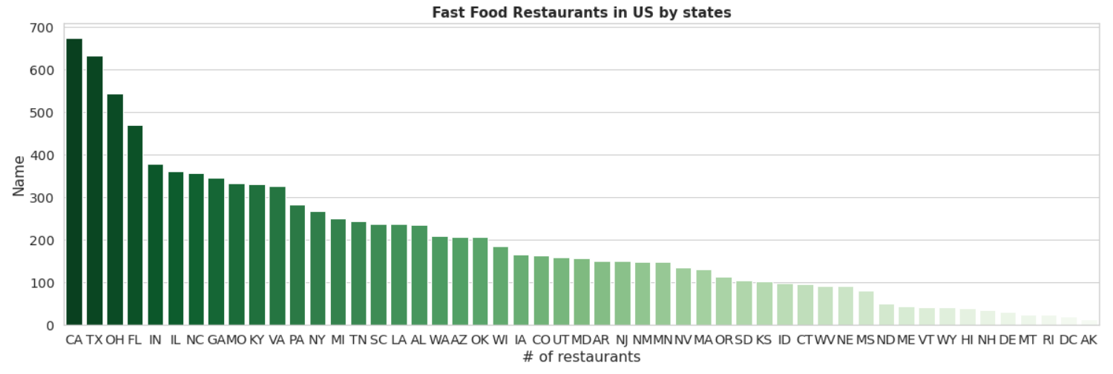
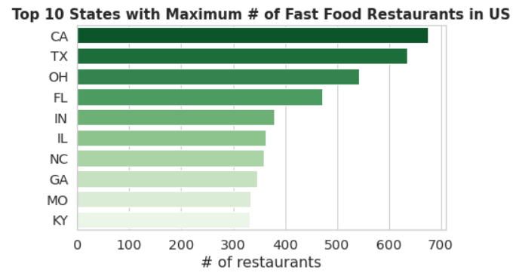
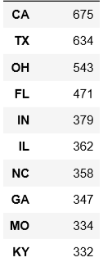
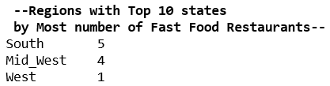
Top 10 States with Maximum # of Fast Food Restaurants
No North East state in Top 10 when arranged states by maximum number of Fast Food Restaurants.

Slide 9
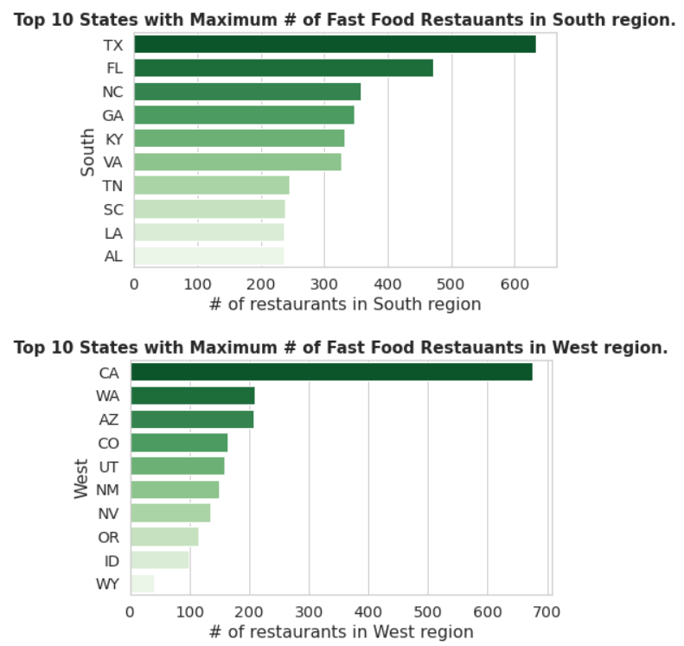
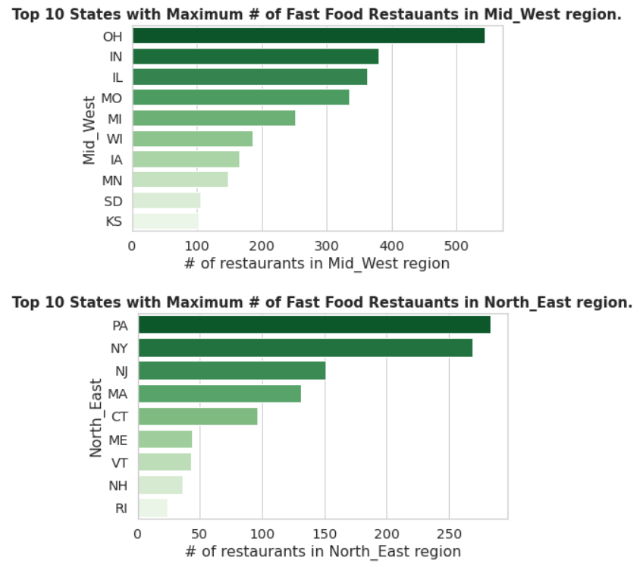
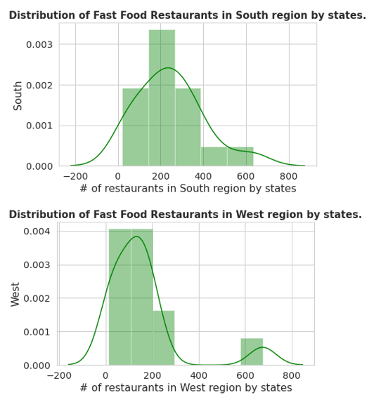
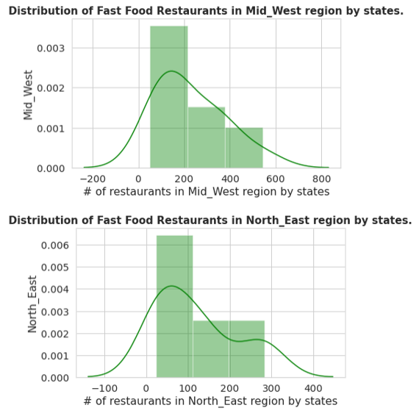
Fast Food Restaurants in USA Regions by States
California state is DOMINANT in entire USA and West region with highest number of Fast Food Restaurants in any state.
Distribution Curve (Number Fast Food Restaurants by state) is SIMILAR for South and North East regions.
Fast Food Restaurants are Uniformly Distributed in Mid West region states.

Slide 10
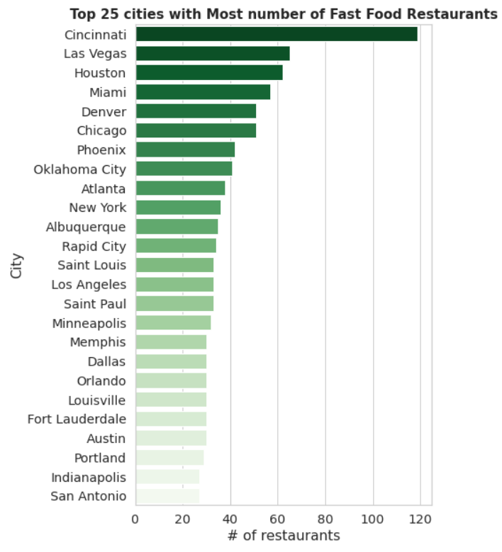
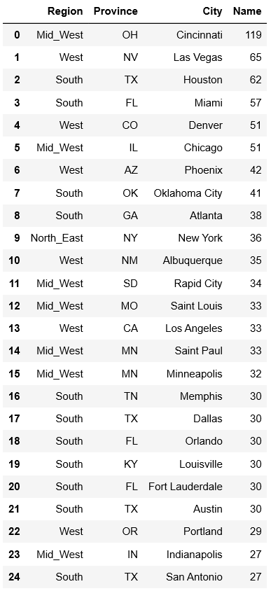

Fast Food Restaurants in US Cities
Cincinnati city has MAXIMUM # of Fast Food Restaurants, almost 2x the # of next USA city in the order.
About 49% of USA cities are with A LONE Fast Food Restaurant.

Slide 11
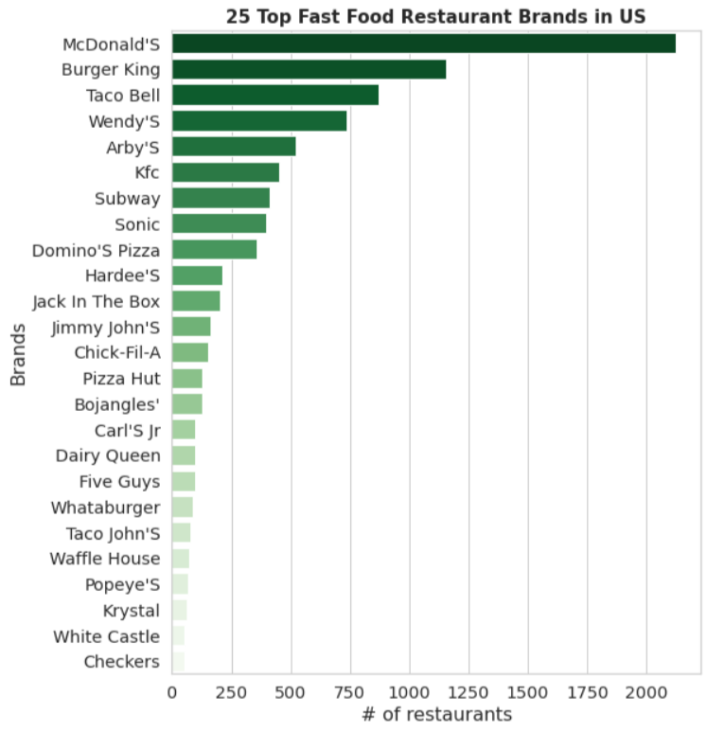
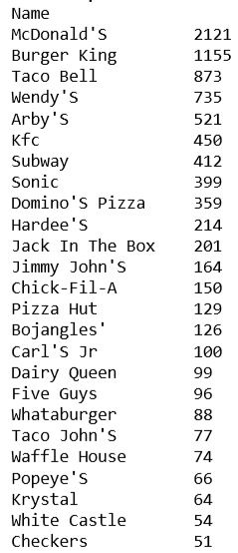

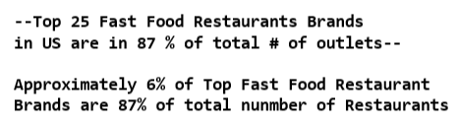
Fast Food Restaurant Brands in US
McDonald’s is the DOMINANT BRAND in all Fast Food Restaurants in USA by # of outlets.

Slide 12
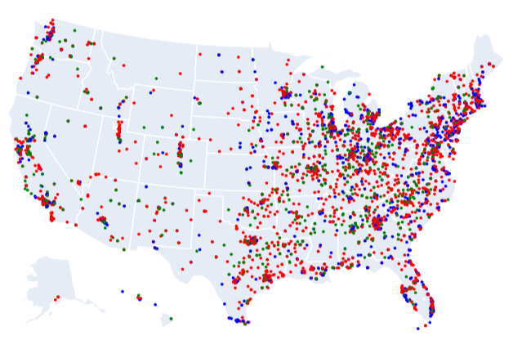
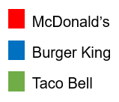

Top 3 Fast Food Restaurant Brands Dominance
McDonald’s, Burger King and Taco Bell are the Top 3 Fast Food Restaurant Brands in USA by # of outlets, wherein McDonald's has a presence in all USA States and a Federal District.

Slide 13
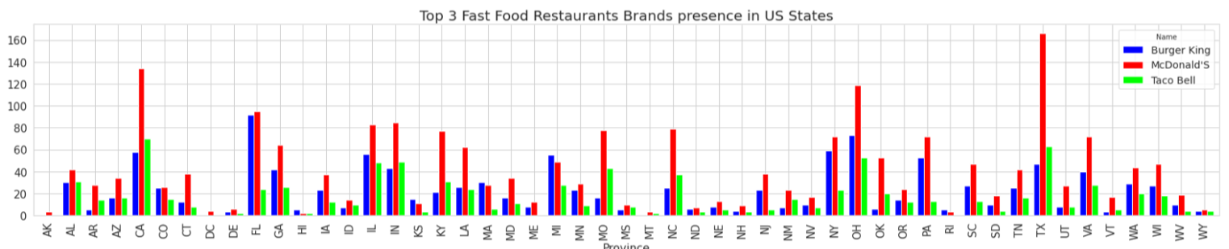
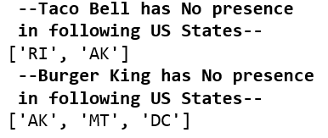
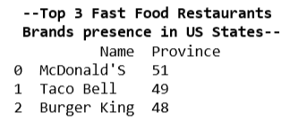
Top 3 Fast Food Restaurant Brands Dominance
Taco Bell has no presence in Rhode Island and Alaska states whereas Burger King has no presence in Alaska, Montana and District of Columbia.
Burger King has a dominance in Hawaii, Kansas, Massachusetts, Michigan and Rhode Island USA states by number of fast food restaurant outlets over McDonald’s.

Slide 14
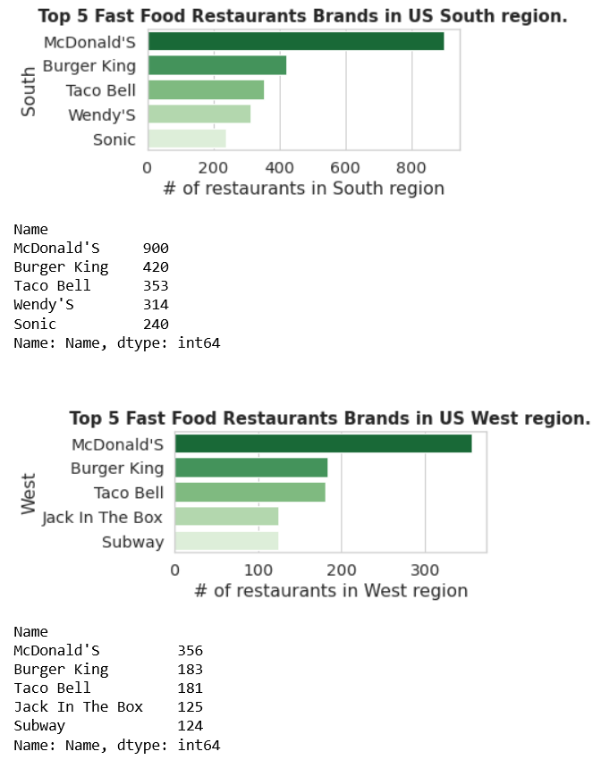
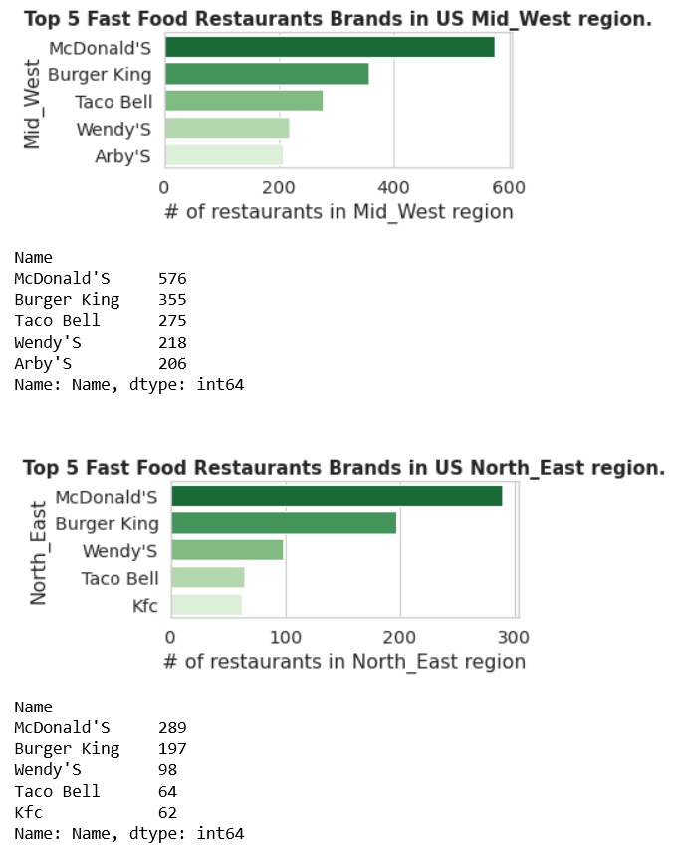
Top 5 Fast Food Restaurant Brands in US Regions
McDonald’s, Burger King, Taco Bell and Wendy’s are the DOMINANT Brands in All USA Regions by number of outlets.
Sonic, Subway, Jack In The Box, Arby’s and KFC show presence in Regional Top 5

Slide 15
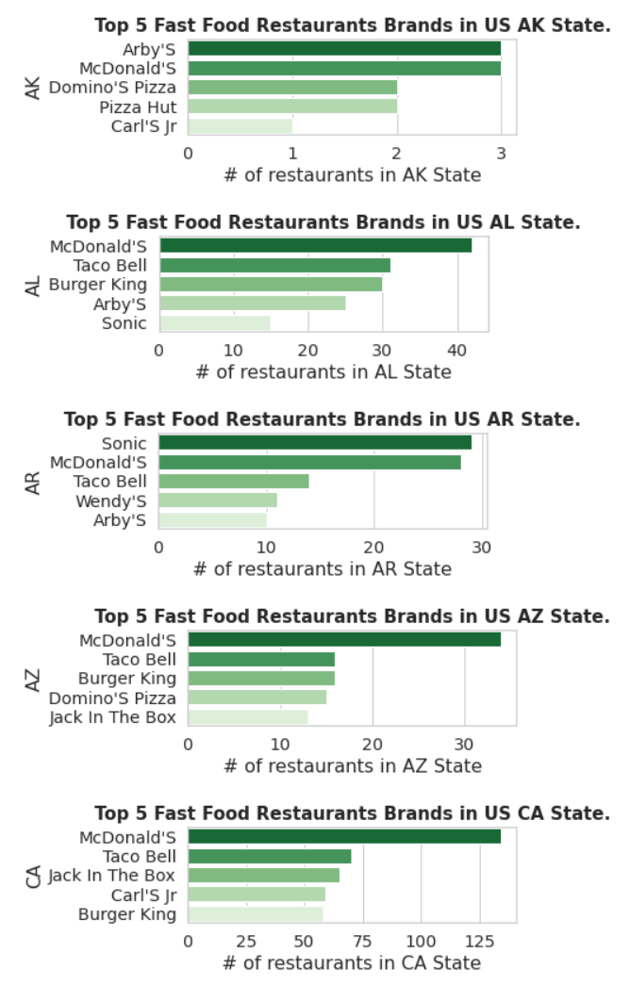
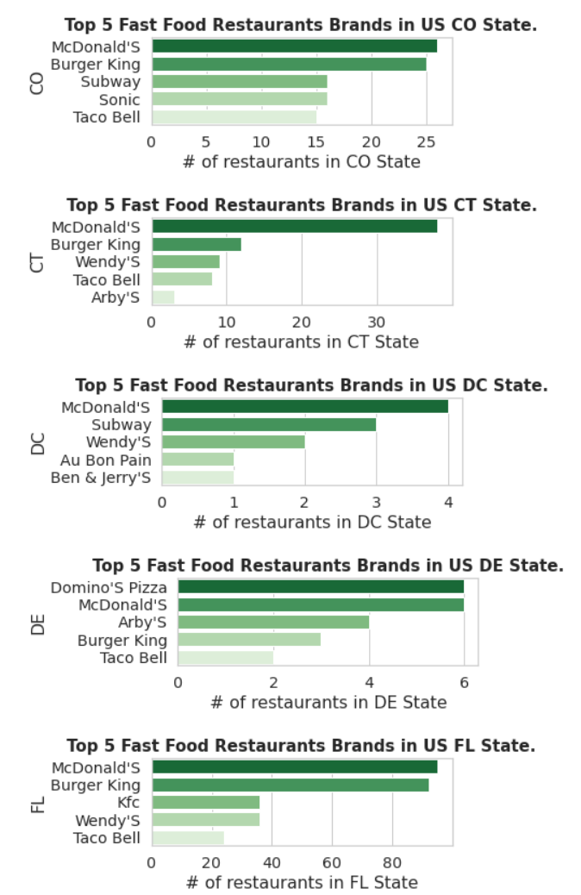
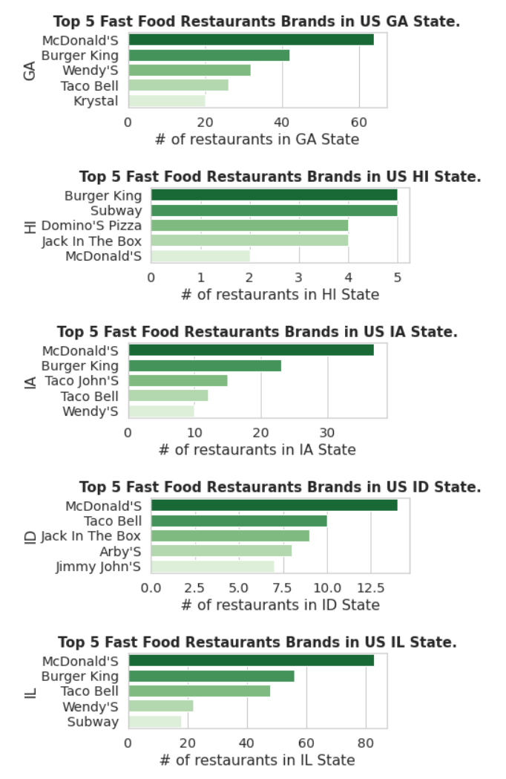
Top 5 Fast Food Restaurant Brands in US States

Slide 16
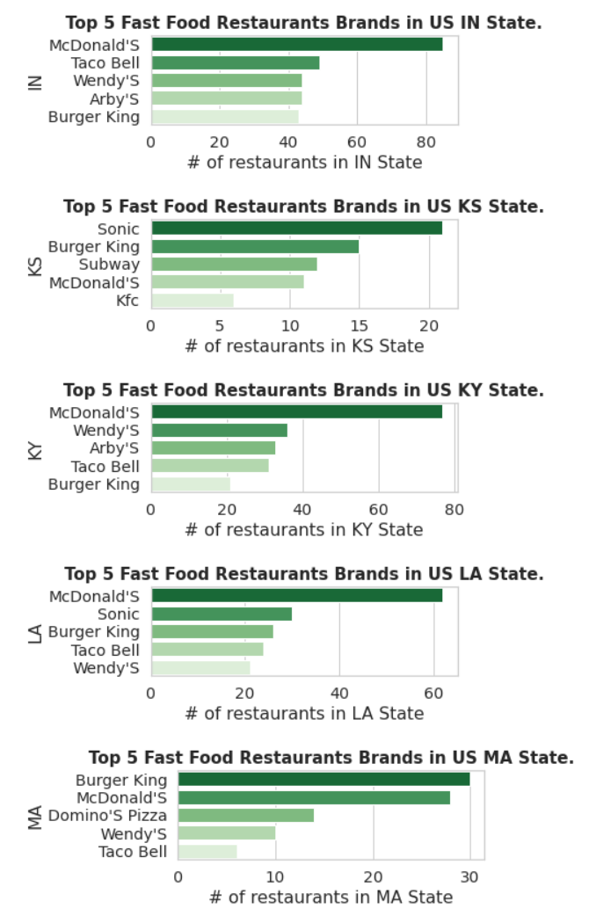
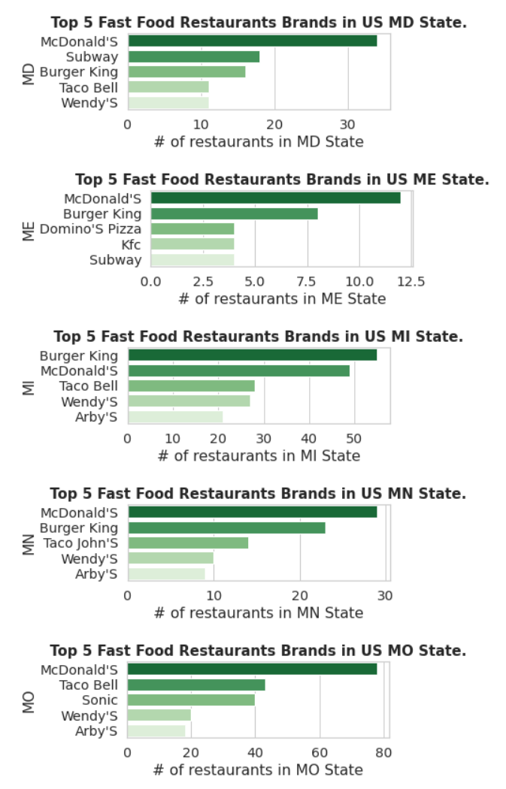
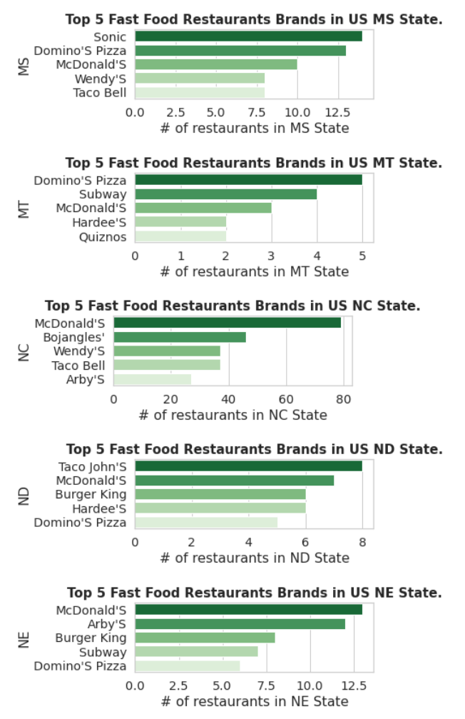
Top 5 Fast Food Restaurant Brands in US States

Slide 17
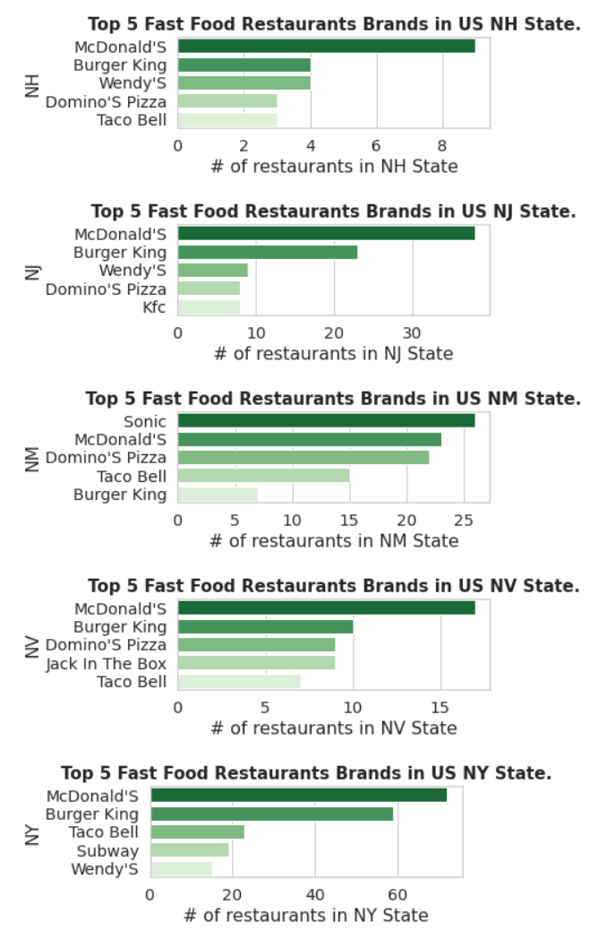
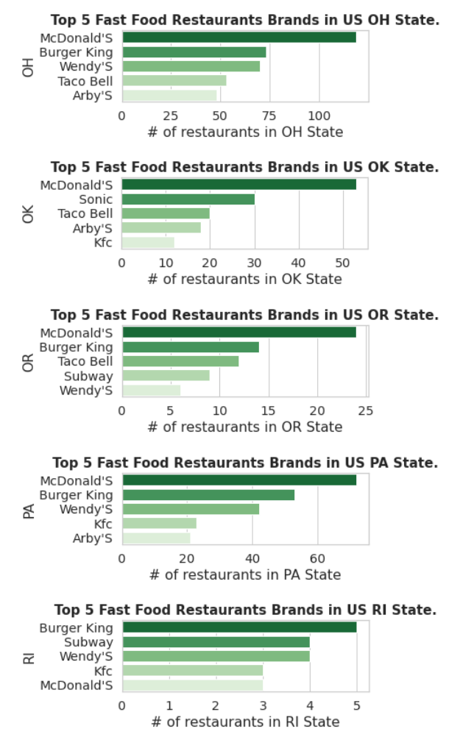
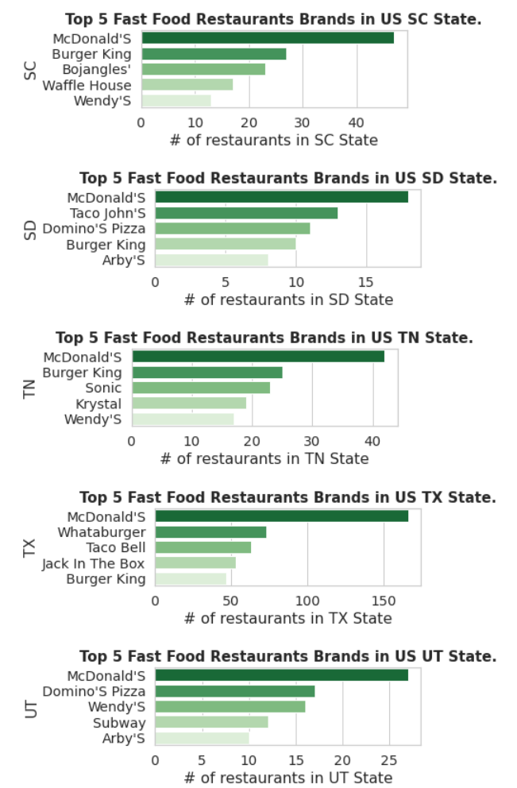
Top 5 Fast Food Restaurant Brands in US States

Slide 18
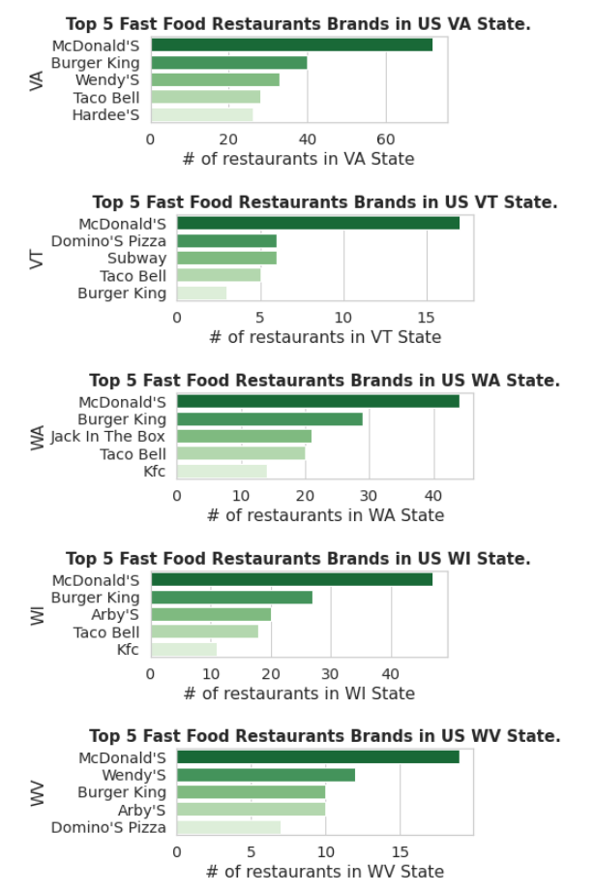
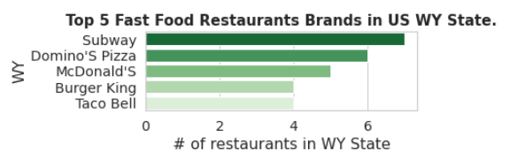
Top 5 Fast Food Restaurant Brands in US States
Alaska, Arkansas, Colorado, Delaware, Florida, Hawaii, Massachusetts, Mississippi and Nebraska USA states have CLOSE RUN between Top 5 Fast Food Restaurant Brands by number of outlets
Close competition criteria:
Top competing brands should have same number of outlets within a state
OR difference between count of outlet<10% AND count of outlet of a leading brand should be >10

Slide 19
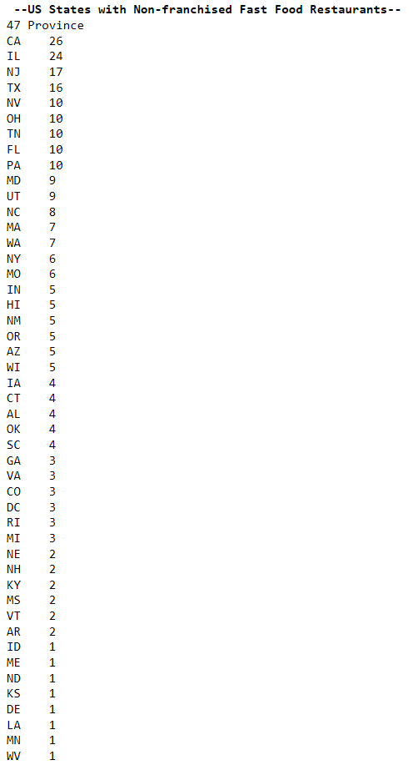
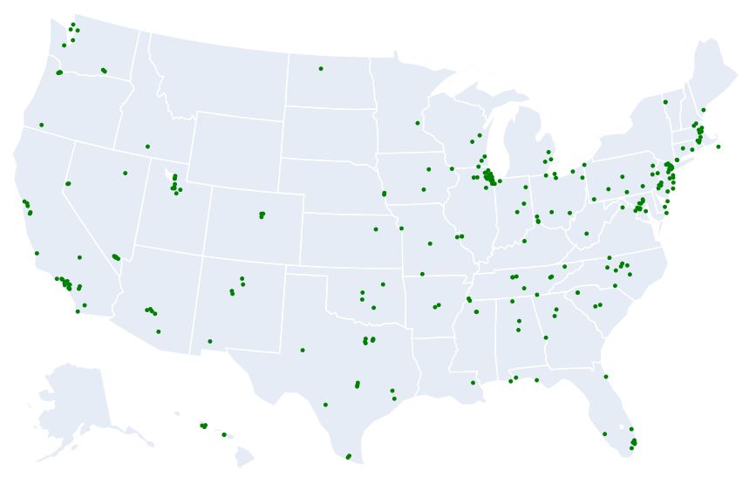


Non Franchised Fast Food Restaurant Brands in US States
Alaska, Montana, South Dakota and Wyoming USA states have NO Non Franchised Fast Food Restaurants.

Slide 20
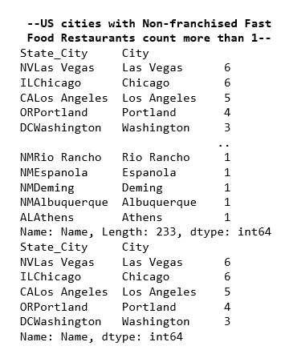
Non Franchised Fast Food Restaurant Brands in US Cities
There are total 233 Cities in US wherein 273 different Non Franchised Fast Food Restaurants are operated.
Las Vegas, Chicago, Los Angeles, Portland and Washington are the top cities among the HIGEST number of Non Franchised Fast Food Restaurants.

Slide 21
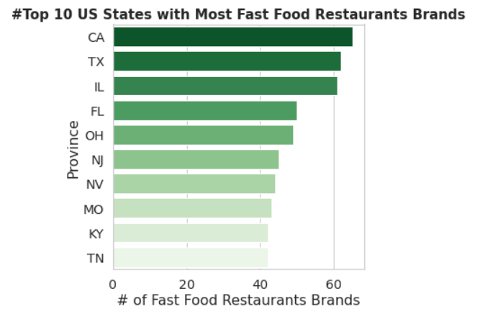
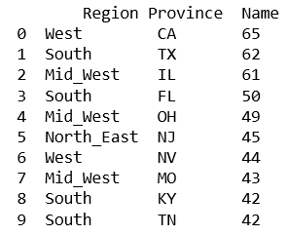
US States with Most Fast Food Restaurant Brands
MAXIMUM Number of Fast Food Restaurant Brands are in California state which is 65.
MINIMUM Number of Fast Food Restaurant Brands are in Alaska state which is 7

Slide 22
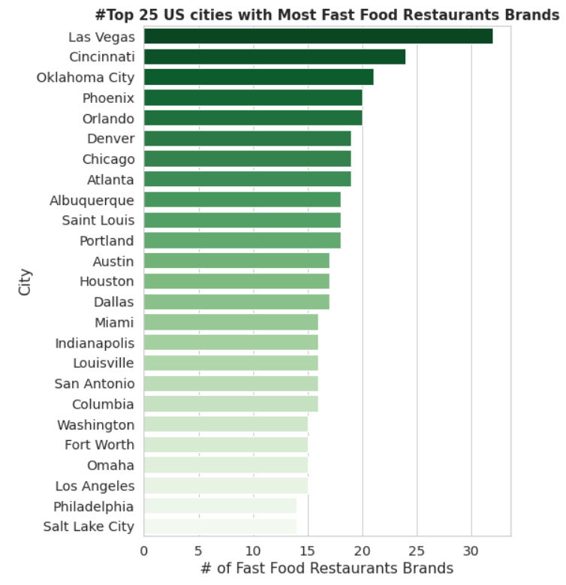
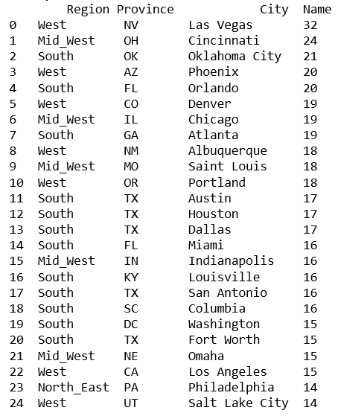
US Cities with Most Fast Food Restaurant Brands
MAXIMUM Number of Fast Food Restaurant Brands are in Las Vegas city which is 32.
However 1740 cities in USA with SOLO Fast Food Restaurant Brand in the town

Slide 23
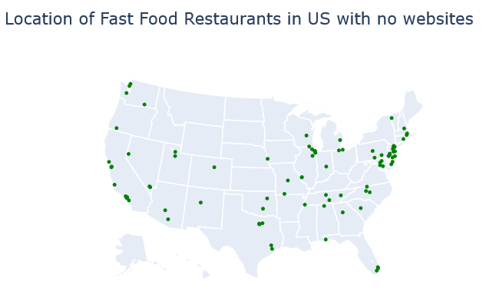
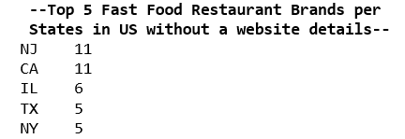

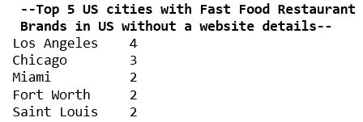

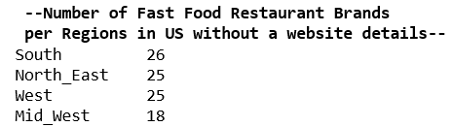

Fast Food Restaurants with No Web Information

Slide 24


Cluster of Fast Food Restaurants
Taco Bell and KFC are the Fast Food Restaurant Brands in USA which are MOST CO-LOCATED with other brands

Slide 25
Investing into McDonald's Fast Food Restaurant Franchise should be the Safest Option due to large spread of the brand across US states and has largest number of outlets in all 4 regions, presence in top 5 leading brands in majority of US states.
Taco Bell would be the another option to invest into as it is positioned as 3rd largest fast food restaurant brand in US by total number of outlets and also it is teaming up with other brands for cost sharing strategy with co-location option.
Las Vegas, Chicago, and Los Angeles would be the preferred cities if one wants to invest into non-franchised fast food restaurant as these cities are currently leading for most non-franchised fast food restaurants in USA.
Recommendations

Slide 26
Thank You
SANKET PADWAL

